Slide 1
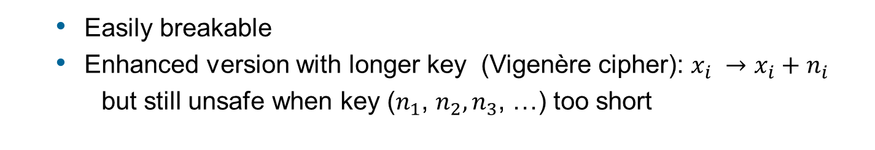
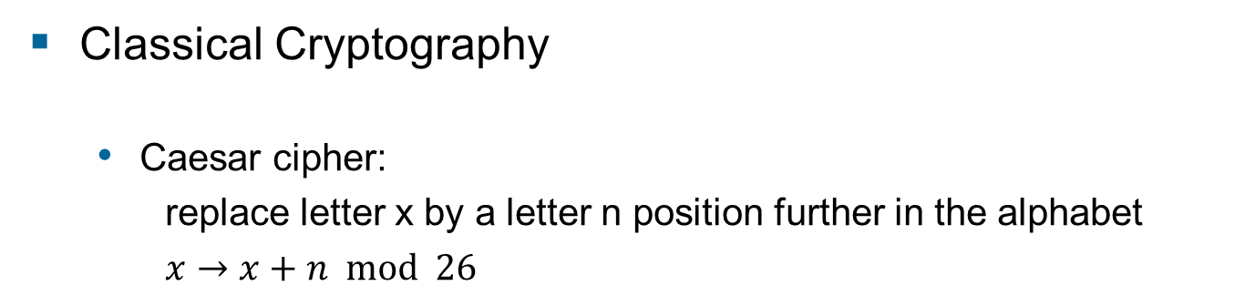
16 Quantum Key distribution
Classical Cryptography
Caesar cipher:
replace letter x by a letter n position further in the alphabet
$x→x+n mod 26$
A
T
A
C
K
A
T
D
A
W
N
plain text
D
W
D
F
N
D
W
G
D
Z
Q
encrypted message
Easily breakable
Enhanced version with longer key (Vigenère cipher): $x_{i} →x_{i}+n_{i}$
but still unsafe when key ($n_{1}$, $n_{2},n_{3}$, …) too short

Slide 2
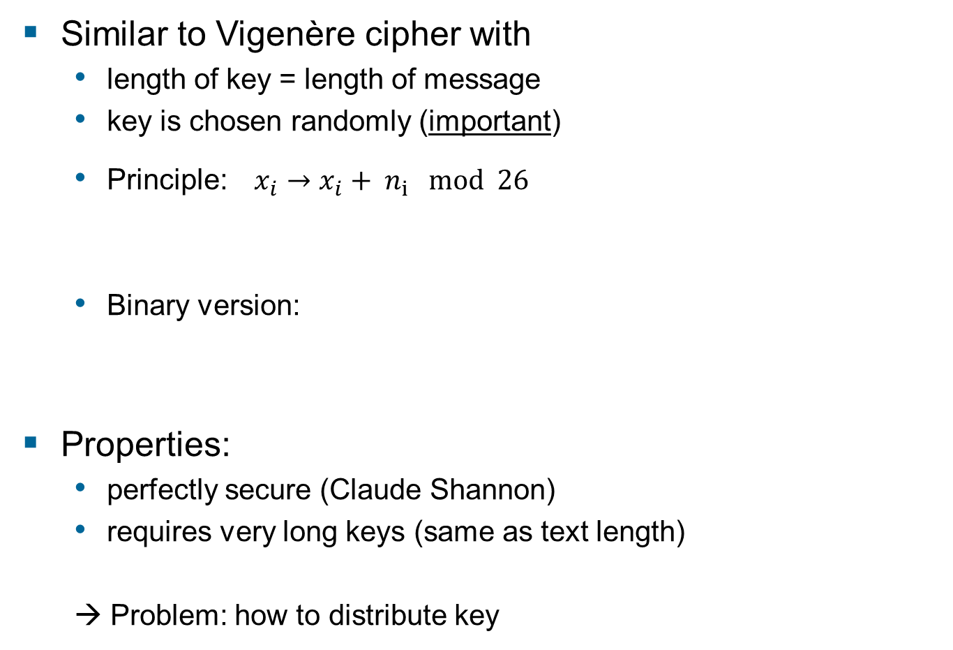
One time pad
Similar to Vigenère cipher with
length of key = length of message
key is chosen randomly (important)
Principle:$x_{i}→x_{i}+ n_{i} mod 26$
Binary version:
Properties:
perfectly secure (Claude Shannon)
requires very long keys (same as text length)
→ Problem: how to distribute key
random number
→ also random number
100101101 message
XOR 101111010 key =====================================================
001010111 encrypted message

Slide 3
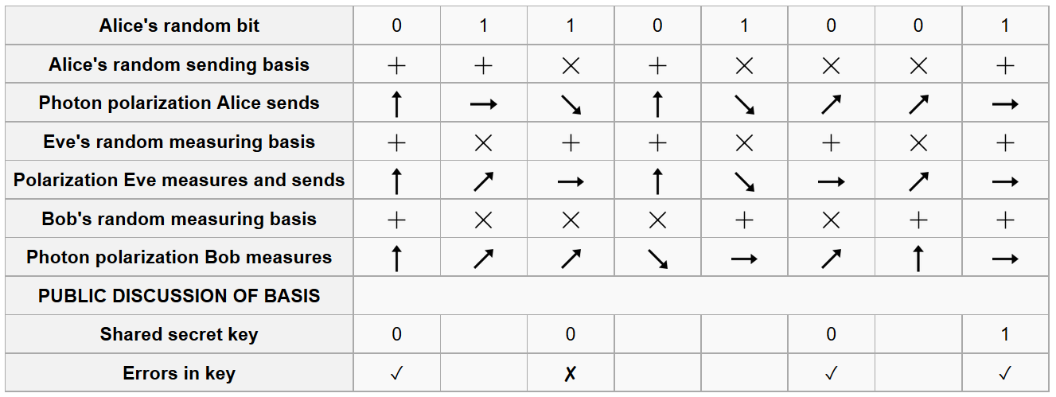
Possible attacking strategies
Intercept-resend (Eve measures photons and sends similar photon to Bob)
Introduces error when Eve measures in different basis than Bob
Eve can be detected

Slide 4
Error correction
In real live, there are always errors in the communication
(even without Eve)
Error correction:
Exchange of parity bits between Alice and Bob
→ Alice+ Bob have same key,
→ Eve gains some information about the key
P=0
P=1
P=1
Alice’s key: 10010 11010 11001
Bob’s key: 10010 11110 11001
P=0
P=0
P=0

Slide 5
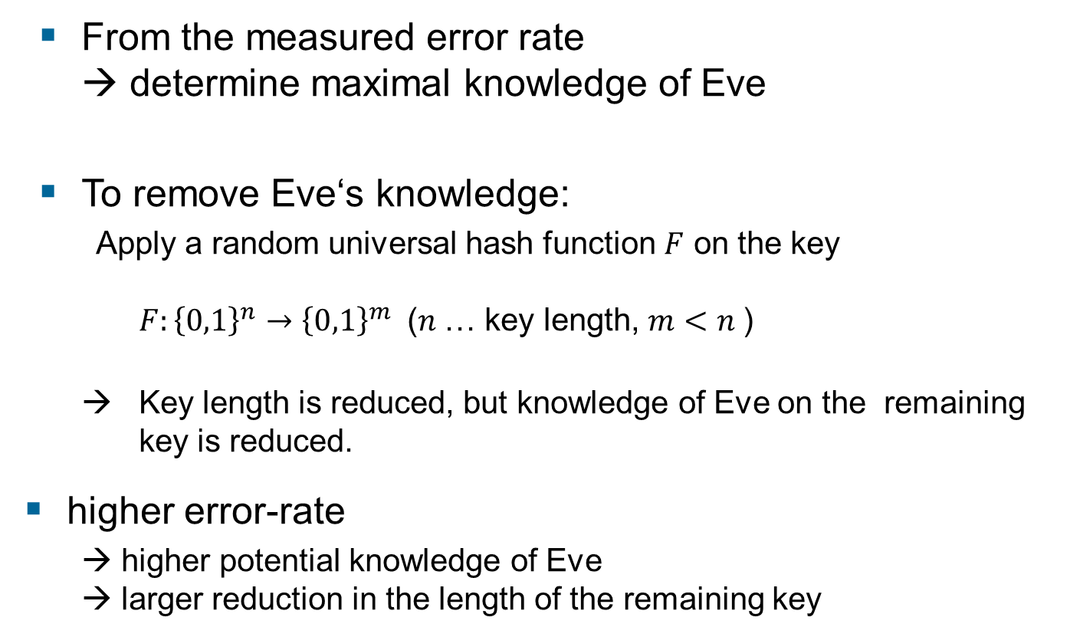
Privacy Amplification
From the measured error rate → determine maximal knowledge of Eve
To remove Eve‘s knowledge:
Apply a random universal hash function $F$ on the key $F:{\left\{0,1\right\}}^{n}→{\left\{0,1\right\}}^{m}$ ($n$… key length, $m<n$)
→ Key length is reduced, but knowledge of Eve on the remaining key is reduced.
higher error-rate
→ higher potential knowledge of Eve → larger reduction in the length of the remaining key

Slide 6
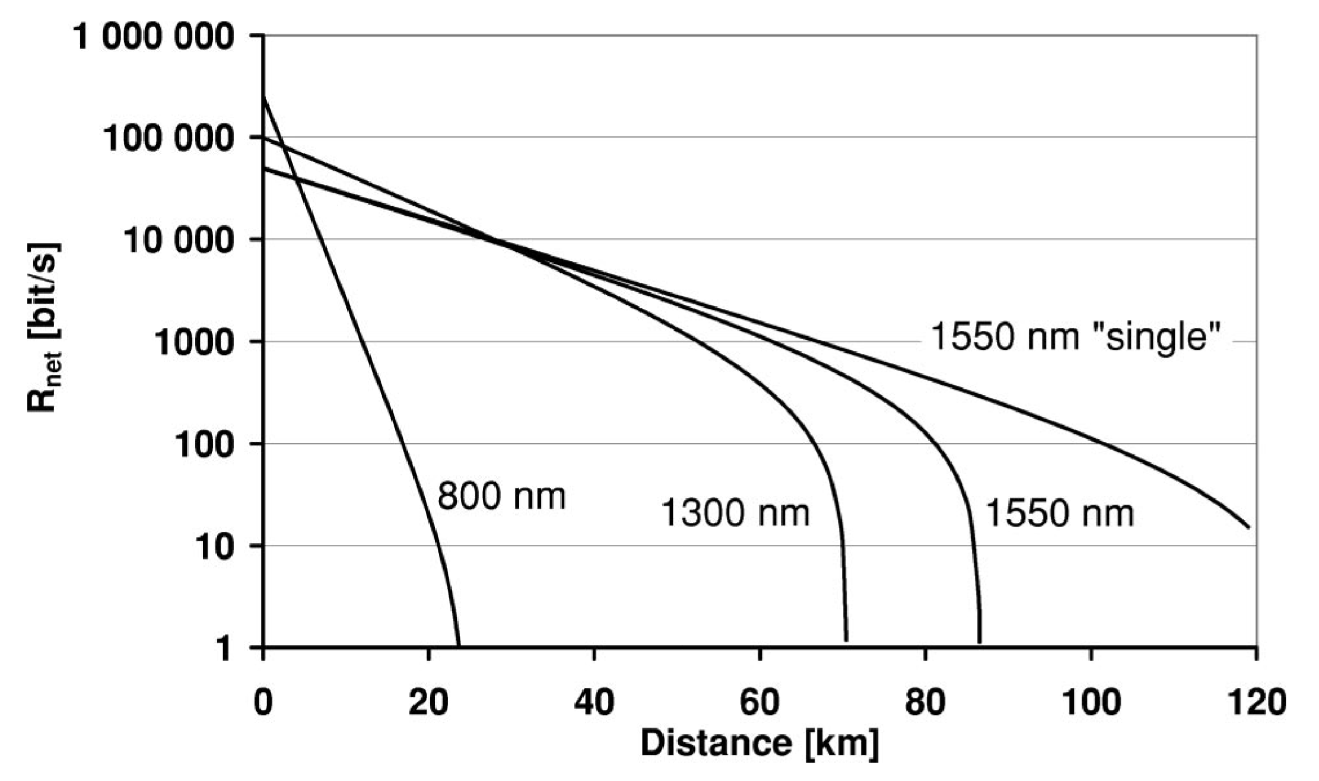
Distance Limits
Error correction and privacy amplification
→ Alice and Bob obtain identical key, Eve has only negligible knowledge
→ But, key generation rate is reduced
As losses + errors increase with communication distance
→ Limit to the maximum distance of QKD
Generation rate of secure key vs. length of optical fiber:
Rev. Mod. Phys. 74, 145 (2002)

Slide 7
Photon-number-splitting attack
Real-life implementations of BB84 protocol use attenuated laser pulses (not single photons)
Typical values: pulse contain about 0.1 photon
Poisson statistics requires:
→ every 10th pulse contains 1 photons and every 100th pulse contains 2 photons
Attack strategy:
Eve performs non-destructive photon number measurement
If pulse contains 2 photons, Eve removes one and measures it
→ Eve knows 10% of the photons without introducing errors

Slide 8
Man-in-the-middle attack
QKD requires communication between Alice and Bob via public channel (key generation, error correction, …)
If attacker has full control of public channel, he can simulate Bob to Alice and vice versa (“man in the middle”)
→ Can gain full information about the message
Solution: Prior to communication, Alice and Bob need already an initial shared secret key
→ use classical (secure) authentication scheme to verify identity of the communication partner

Slide 9
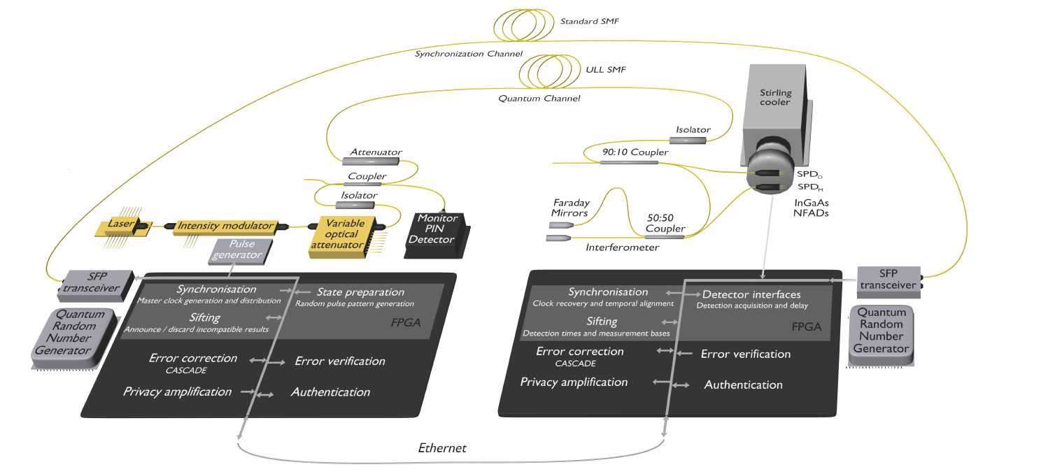

Experimental demonstrations
Fiber based QKD (300 km)
(ID-Quantique,
Geneva)

Slide 10
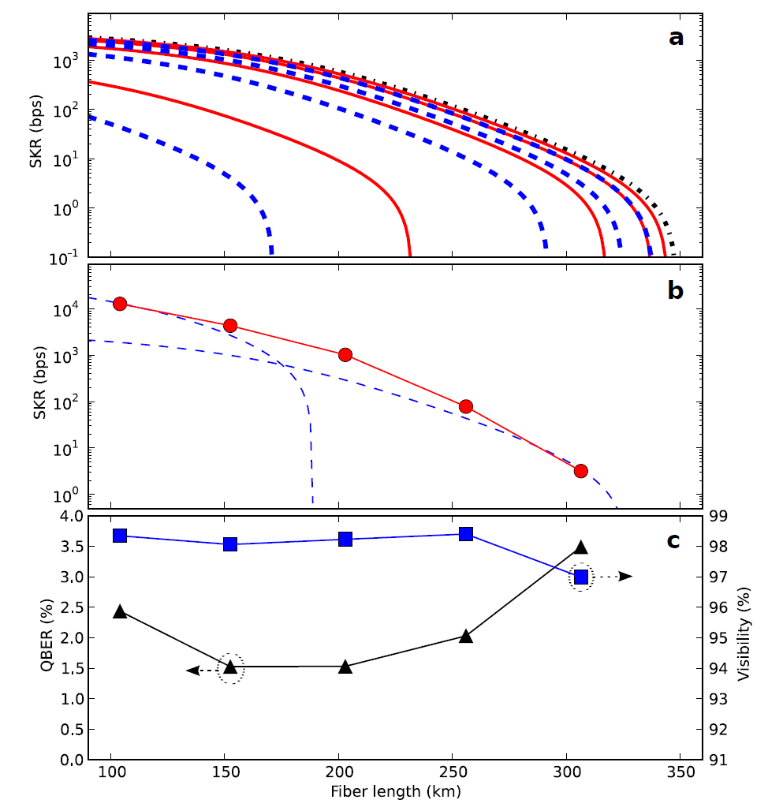
Experimental demonstrations
Fiber based QKD (300km)
(ID-Quantique,
Geneva)
Commercial company for fiber intregrated QKD systems and accesoires
Key generation rate
Nature Photonics 9, (2015) 163-168

Slide 11
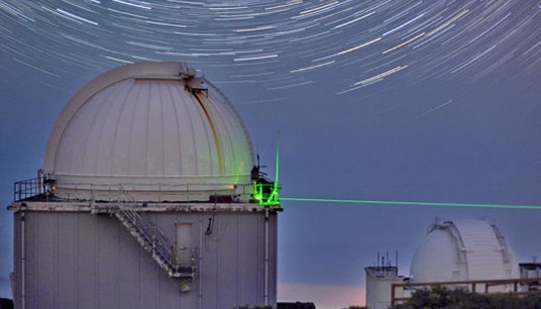
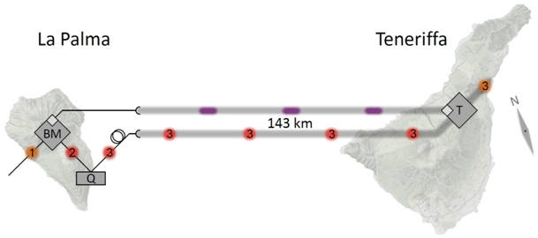
Experimental demonstrations
Free-space QKD (Munich-Vienna cooperation)
Implementation of BB84 + Ekert Protocol
Experimental key rates: ~10 bits/s
Distance similar to distance to orbit satellites
→ first step to satellite based QKD
Physical Review Letters 98, 010504 (2007)
Nature Physics 3, 481 (2007)

Slide 12
Outlook
How to overcome distance limits ?
In classical communication → optical amplifier (repeater)
Not possible in quantum communication (no-cloning theorem)
quantum repeater

